Slide 1
Guide to Finding Metadata for SRR Runs on NCBI

Slide 2
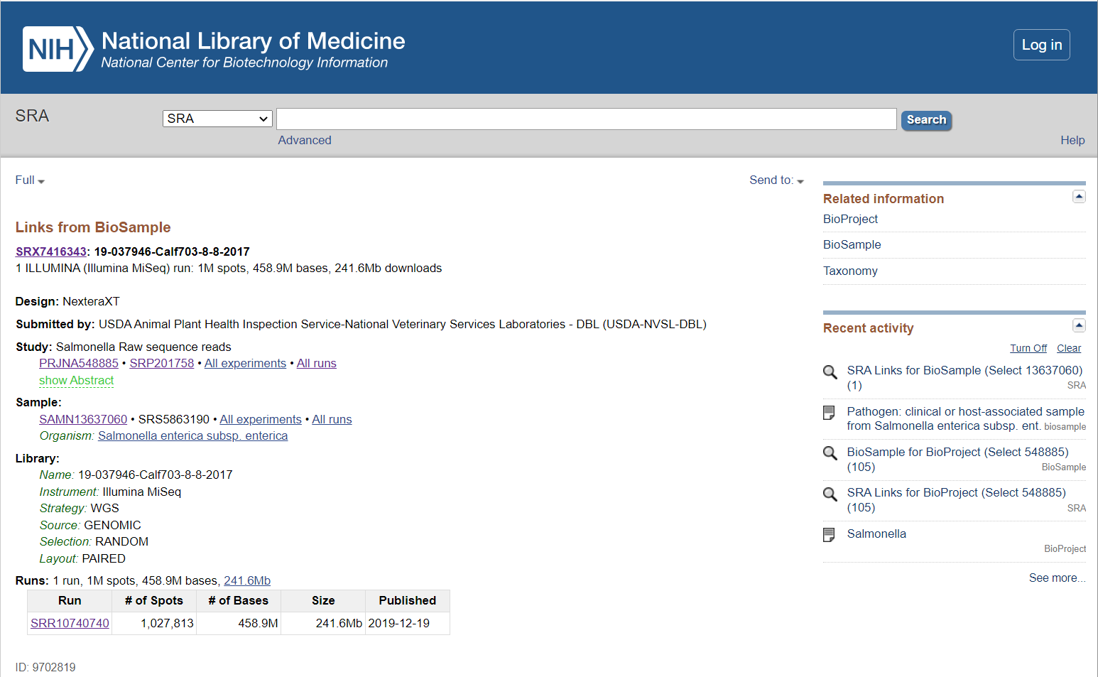
Find SRA BioSample Page on NCBI
Click to retrieve metadata for multiple SRA Runs that are under the same “Study”.
Click to retrieve metadata for single run.

Slide 3
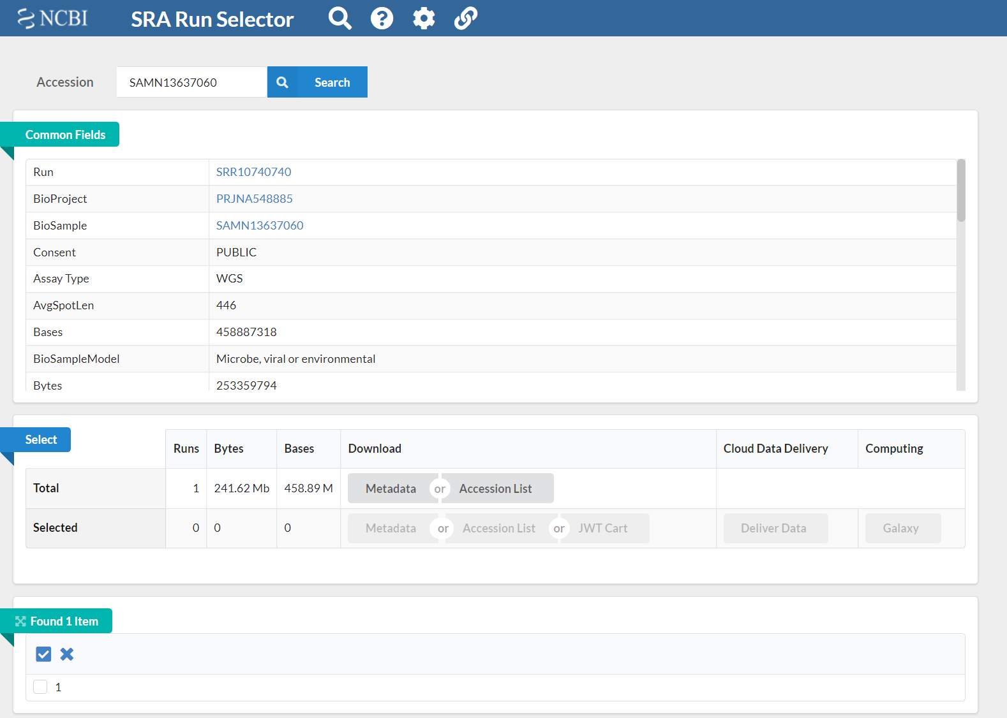
Metadata Page for Individual SRR Runs
Click Metadata for text file for individual run.

Slide 4
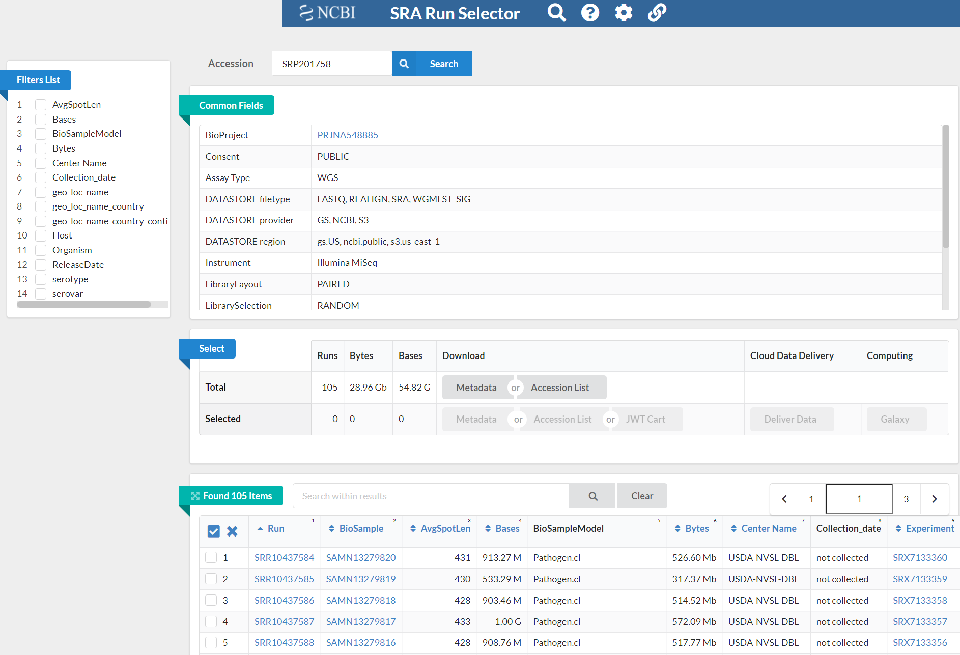
Multiple SRR Runs
Click Metadata for text file with all runs metadata

Slide 5
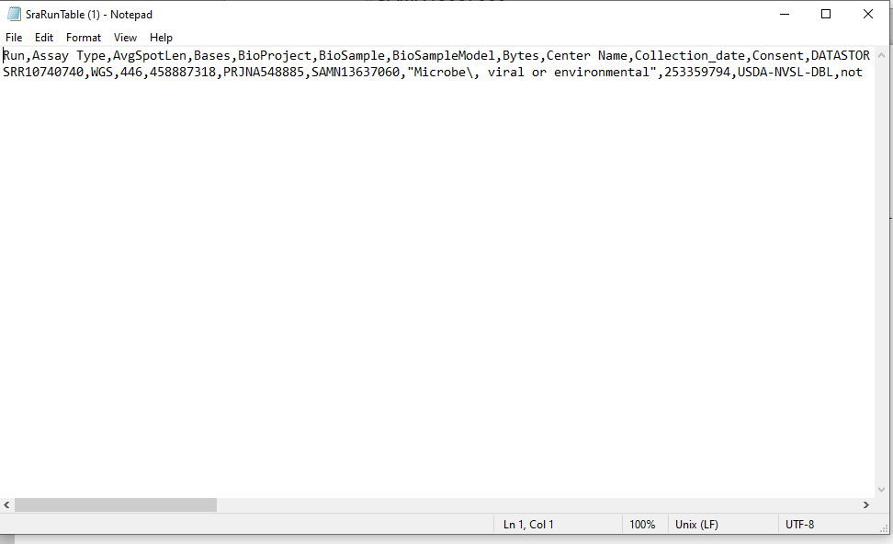
Example Metadata File

